Slide 1
Advanced Gradient Descent Methods
Regularization

Slide 2
CONTENTS
1
5
3
BGD
SGD
AdaDelta
NAG
2
4
AdaGrad
momentum

Slide 3
CONTENTS
6
10
8
RMSProp
L2 Norm
Regularization
7
9
L1 Norm
ADAM

Slide 4
Batch
Gradient
Descent
BGD

Slide 5
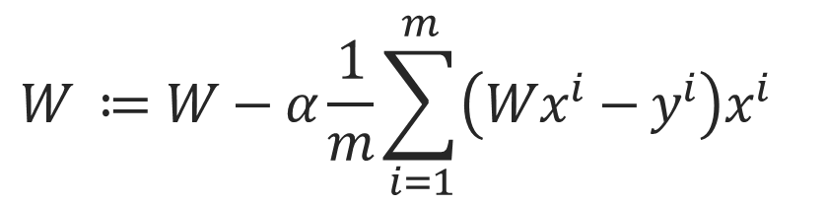
BGD
Based on Batch(total Data)
$$W ≔W−α\frac{1}{m}\sum_{i=1}^{m}{\left(Wx^{i}−y^{i}\right)x^{i} }$$

Slide 6
Stochastic
Gradient
Descent
SGD

Slide 7
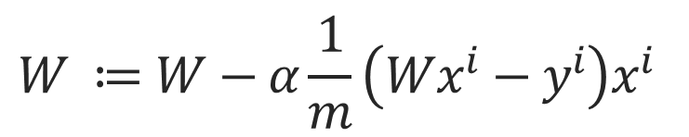
SGD
Based on (One Data)
$$W ≔W−α\frac{1}{m}\left(Wx^{i}−y^{i}\right)x^{i}$$

Slide 8
Mini-Batch
Gradient
Descent
MSGD

Slide 9
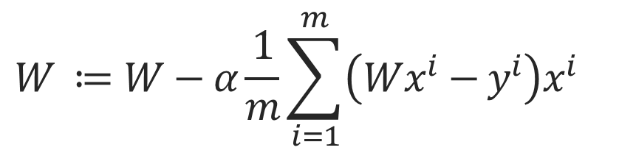
MSGD
Based on Mini Batch (One Data)
$$W ≔W−α\frac{1}{m}\sum_{i=1}^{m}{\left(Wx^{i}−y^{i}\right)x^{i} }$$

Slide 10
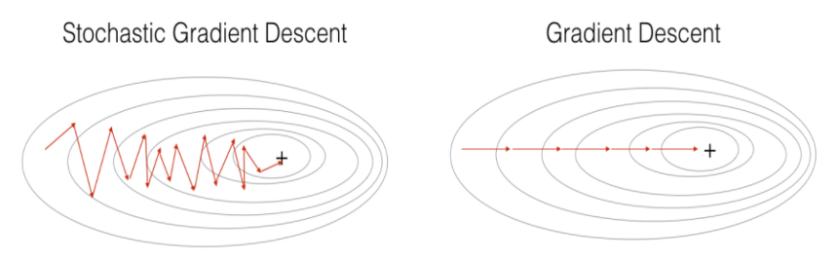
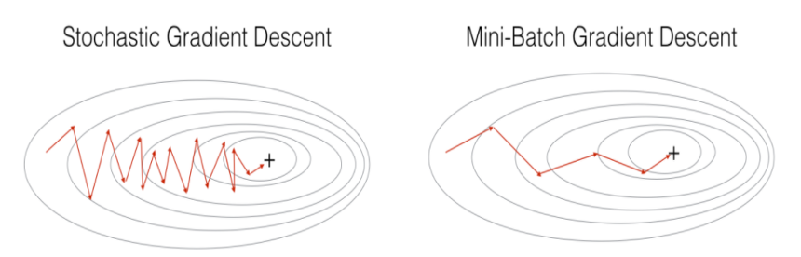
Visualize
출처 : https://light-tree.tistory.com/133

Slide 11
Momentum
Momentum

Slide 12
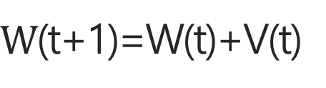
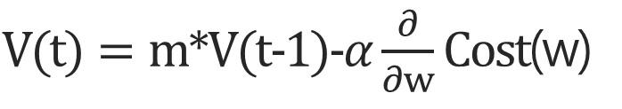

Momentum
$L$ike Acceleration => Rolling a ball
$V(t)=m∗V(t−1)−α\frac{∂}{∂w}Cost$(w)
V(0)=0
$W$(t+1)=W(t)+V(t)
W=weight

Slide 13
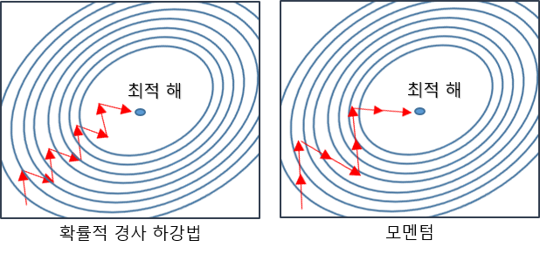
Momentum
출처 : https://twinw.tistory.com/247

Slide 14
Nesterov
Accelrated Gradient
NAG

Slide 15
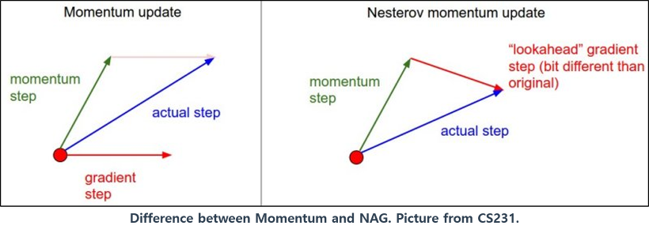
NAG
In Momentum Step, gradient
출처 : https://twinw.tistory.com/247

Slide 16
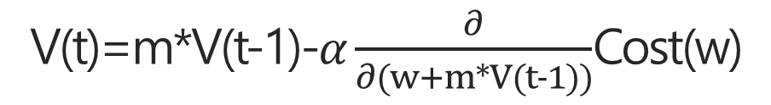
NAG
V(t)=m*V(t-1)-$α\frac{∂}{∂(w+m∗V(t−1))}$Cost(w)
W(t+1)=W(t)+V(t)

Slide 17
NAG

Slide 18
Adaptive
Gradient
Adagrad

Slide 19
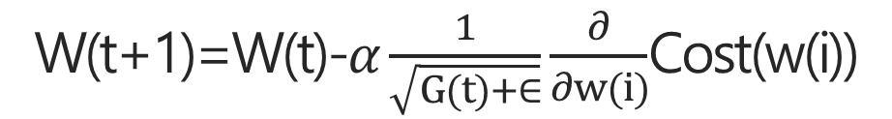
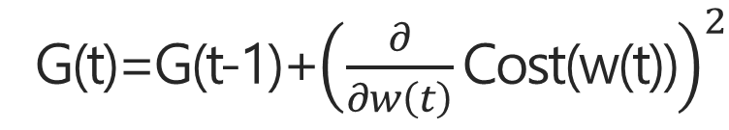
Adagrad
G(t)=G(t-1)+${\left(\frac{∂}{∂w\left(t\right)}\text{Cost}\text{(}\text{w}\text{(}\text{t}\text{))}\right)}^{2}$
G(t) = Vector W[i] element
W(t+1)=W(t)-$α\frac{1}{\sqrt{G(t)+∈}}\frac{∂}{∂w(i)}$Cost(w(i))
W(t) = Vector W[i] element

Slide 20

Adagrad
Problem
1. G(0)=0 and G(t)=0, insert $∈$
2. Infinite Training G(t) is infinite

Slide 21
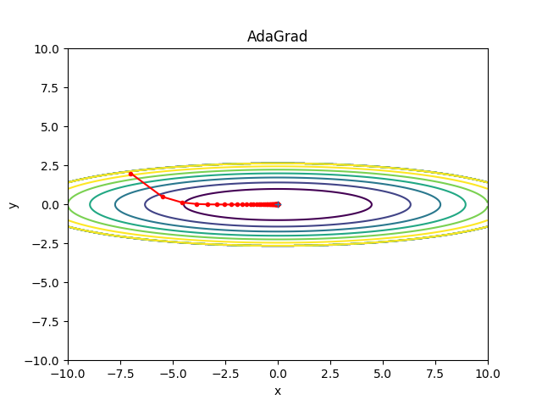
Adagrad
출처 : https://twinw.tistory.com/247

Slide 22
Adaptive
Gradient
RMSProp

Slide 23
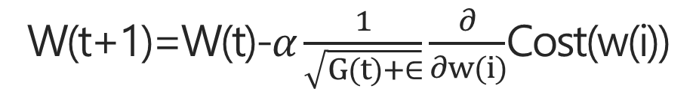
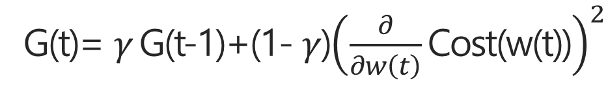

RMSProp
It Complements the adagrad
G(t)= $γ$G(t-1)+(1- $γ$)${\left(\frac{∂}{∂w\left(t\right)}\text{Cost}\text{(}\text{w}\text{(}\text{t}\text{))}\right)}^{2}$
G(t) = Vector W[i] element
W(t+1)=W(t)-$α\frac{1}{\sqrt{G(t)+∈}}\frac{∂}{∂w(i)}$Cost(w(i))
W(t) = Vector W[i] element
$γ$`s Value => 0.9~0.999

Slide 24
Adaptive
Gradient
AdaDelta

Slide 25
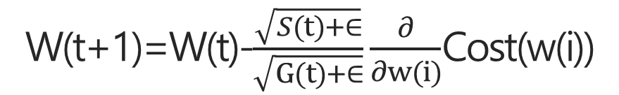
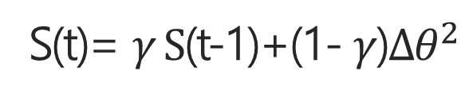

Adadelta
Update Parameter W, W`s unit ?
Remove Learning Rate
G(t)= $γ$G(t-1)+(1- $γ$)${\left(\frac{∂}{∂w\left(t\right)}\text{Cost}\text{(}\text{w}\text{(}\text{t}\text{))}\right)}^{2}$
G(t) = Vector W[i] element
S(t)= $γ S$(t-1)+(1- $γ$)$∆θ^{2}$
Hesian Matrix
W(t+1)=W(t)-$\frac{\sqrt{S(t)+∈}}{\sqrt{G(t)+∈}}\frac{∂}{∂w(i)}$Cost(w(i))
W(t) = Vector W[i] element
$γ$`s Value => 0.9~0.999
Hesian Matrix : https://bskyvision.com/661
참고 https://hiddenbeginner.github.io/deeplearning/2019/09/22/optimization_algorithms_in_deep_learning.html

Slide 26
Animation
애니메이션
http://shuuki4.github.io/deep%20learning/2016/05/20/Gradient-Descent-Algorithm-Overview.html

Slide 27
Adaptive
Moment
Estimation
Adam

Slide 28
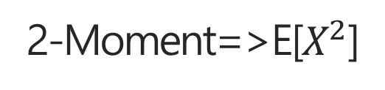
Adam
Moment + Adaptive
Moment is not Momentum Probability Moment
What is Moment ? => Kocw 김충락 교수님(수리통계학)
1-Moment=>E[X]
Not Known Moment => Estimation
2-Moment=>E[$X^{2}$]
참고 https://hiddenbeginner.github.io/deeplearning/2019/09/22/optimization_algorithms_in_deep_learning.html

Slide 29



Adam
$$m_{t}=β_{1}m_{t−1}+\left(1+β_{1}\right)g_{t}$$
$$v_{t}=β_{2}v_{t−1}+\left(1+β_{2}\right)g_{t}^{2}$$
If Initial m, v is 0 , weight=>Zero biased
If decay rate is small, ${(β}_{1}$, $β_{2} close one)$weight=>biased
$$m_{t}=β_{1}m_{t−1}+\left(1+β_{1}\right)g_{t}$$
참고 https://hiddenbeginner.github.io/deeplearning/2019/09/22/optimization_algorithms_in_deep_learning.html

Slide 30
Regularization
Regularization

Slide 31
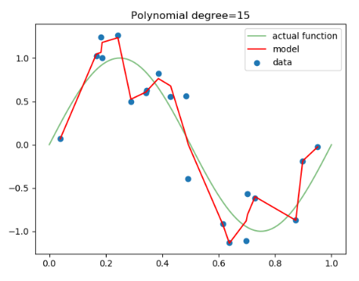
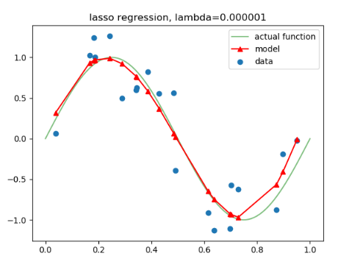
Regularization
참고,출처 : https://light-tree.tistory.com/125

Slide 32
Lasso
L1-Norm

Slide 33
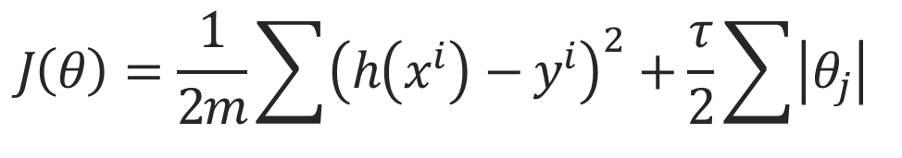
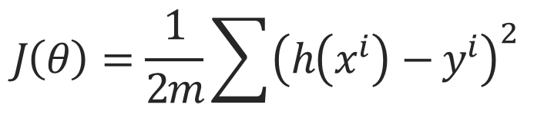
L1-Norm
Lasso
$$J\left(θ\right)=\frac{1}{2m}\sum{{\left(h\left(x^{i}\right)−y^{i}\right)}^{2}}$$
$$J\left(θ\right)=\frac{1}{2m}\sum{{\left(h\left(x^{i}\right)−y^{i}\right)}^{2}+\frac{τ}{2}}\sum{\left|θ_{j}\right|}$$
참고,출처 : https://light-tree.tistory.com/125

Slide 34
Ridge
L2-Norm

Slide 35
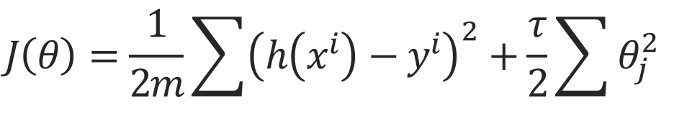
L2-Norm
Ridge
$$J\left(θ\right)=\frac{1}{2m}\sum{{\left(h\left(x^{i}\right)−y^{i}\right)}^{2}}$$
$$J\left(θ\right)=\frac{1}{2m}\sum{{\left(h\left(x^{i}\right)−y^{i}\right)}^{2}+\frac{τ}{2}}\sum{θ_{j}^{2}}$$
참고,출처 : https://light-tree.tistory.com/125

Slide 36
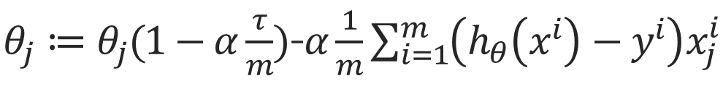
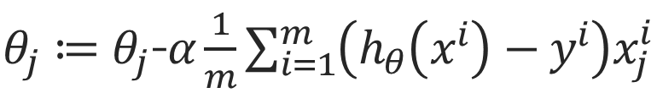
L2-Norm
Ridge
$θ_{j}≔θ_{j}$-$α\frac{1}{m}\sum_{i=1}^{m}{\left(h_{θ}\left(x^{i}\right)−y^{i}\right)x_{j}^{i}}$
$θ_{j}≔θ_{j}(1−α\frac{τ}{m})$-$α\frac{1}{m}\sum_{i=1}^{m}{\left(h_{θ}\left(x^{i}\right)−y^{i}\right)x_{j}^{i}}$
참고,출처 : https://light-tree.tistory.com/125

Slide 37
감사합니다
THANK YOU

